Slide 1

Copyright © www.ITbodhi.com

Slide 2
A recommendation engine filters the data using different algorithms and recommends the most relevant items to users. It first captures the past behavior of a customer and based on that, recommends products which the users might be likely to buy.
Recommender Systems enhances user experience and provide more exposure to larger inventory.
These systems make companies dollars as recommending a product to a user might yield a sale or make the user think about whether to purchase a product or not. It’s like a salesman recommending product but a virtual one without any human intervention but a better recommendation based on your history.
Copyright © www.ITbodhi.com

Slide 3

Recommender Systems is like a friend suggesting you.
Copyright © www.ITbodhi.com

Slide 4
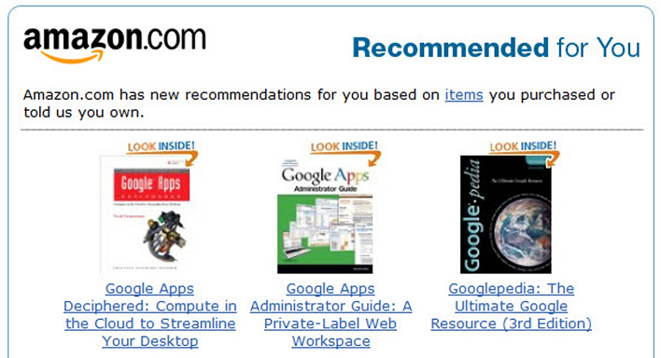
Use cases of Recommender System
Amazon
When we buy something or browse anything on Amazon, we see recommended products based on our taste or search results on the page.
Copyright © www.ITbodhi.com

Slide 5
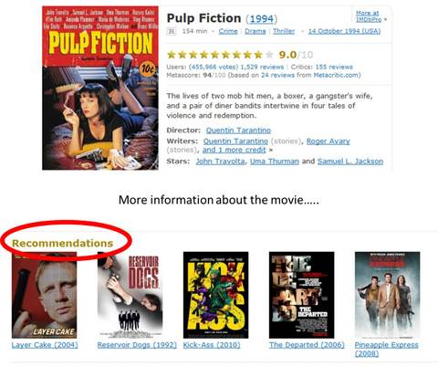
IMDb
When we rate some TV show or movies on IMDb. IMDb recommends based on the important details of the show i.e cast, genre, sub-genre, plot, summary.
Copyright © www.ITbodhi.com

Slide 6
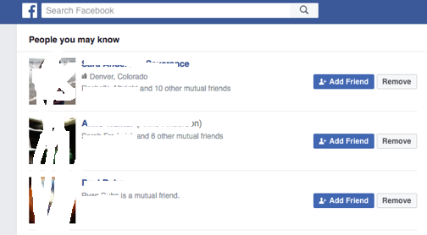
Facebook
Facebook, Instagram uses a recommender system on a wider scale for suggesting news feeds and friends.
Often in the News Feed section user is bombarded with articles similar to each other based on your likes and pages you follow. It creates an unconscious bias among the user.
Copyright © www.ITbodhi.com

Slide 7
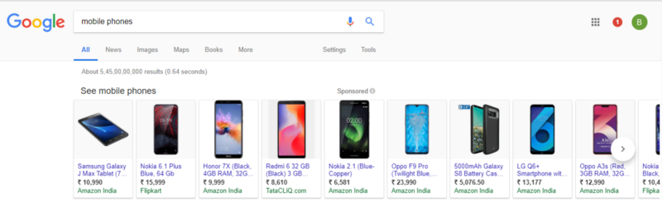
Google
Whenever we search anything on Google when logged in. Google registers it in history and recommends us products based on previous searches. Not surprisingly google’s more than 90% revenue is generated through advertising. Relevant searches also take into account the location at times which has concerns about privacy and Google is often targeted.
Copyright © www.ITbodhi.com

Slide 8
Relationships
User-Product Relationship
Some users have an affinity or preference towards specific products that they need.
Eg: A cricket player has a preference for cricket related items thus the e-commerce website will build a user product relation of player->cricket.
Product-Product Relationship
When we look within products, some products are similar in nature. Looks or description wise they have similarity between each other.
eg: Books of the same genre, Music from the same genre, Dishes from the same cuisine, News Articles from a particular event.
User-User Relationship
Some customers have similar taste with respect to a particular product or service.
eg: Mutual Friends, Similar Backgrounds, Similar Age
These relationships can provide systems with tremendous insight as well as an understanding of customers. The insight understood can be monetized as relevant suggestions often lead to purchase.
Copyright © www.ITbodhi.com

Slide 9
Data
User Behavior Data
Useful information about the engagement of the user on the product. It can be collected from rating, clicks, purchase history.
User Demographic Data
User information related to the user’s personal information such as age, education, income, location.
Product Attribute Data
Information related to product’s attribute such as genre in case of books, cast in case of movies, cuisine in case of food.
Copyright © www.ITbodhi.com

Slide 10
Recommender System Functioning
How do we provide data for Recommender System?
Data can be provided in a variety of ways. There are 2 particularly important methods i.e explicit and implicit rating.
Explicit Ratings
Ratings provided by user i.e they give their opinion on the product or service are called explicit ratings. They infer the user’s preference. Ratings are hard to get as the user’s seldom rate products.
eg: Star Ratings, Reviews, Feedback, Likes, Following
Implicit Ratings
Ratings provided by the user on interaction with the item is called implicit ratings. They infer user’s behavior and is easy to get as users are subconsciously clicking and is user’s natural behavior towards services.
eg: Clicks, Views, Purchases.
Note: Views and Purchases can be a better entity to recommend as you have spent time and money on it which is most crucial for a user.
Amazon has your purchase data. Youtube has your viewing data.
Copyright © www.ITbodhi.com

Slide 11
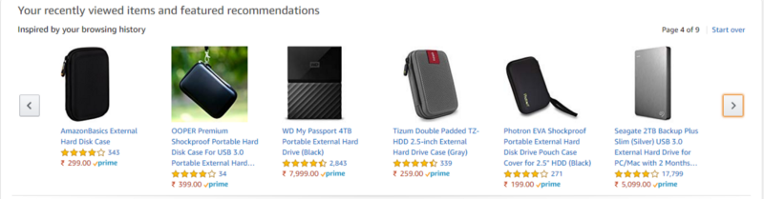
Product Similarity(Item-Item Filtering)
The most useful system for suggesting user a product by how much the user would like the product. If the user is browsing or searching for a particular product, they can be shown similar products.
Users often expect to buy products they want quickly and move on if they have a hard time finding the relevant product. When the user clicks on one product we can give another product which is similar or If the user buys the product we can email the user advertisement or coupons based on a similar product.
Product similarity is particularly useful when we don’t know much of the user yet we can recommend user based on the product their viewing.
Copyright © www.ITbodhi.com

Slide 12
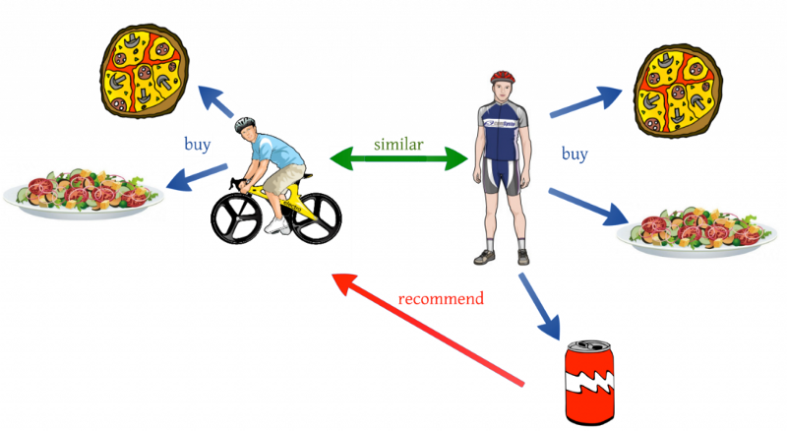
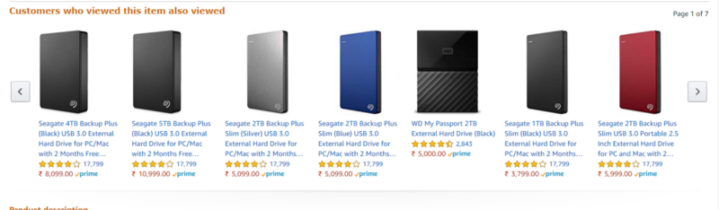
User Similarity(User-User Filtering)
User similarity is for checking the difference between the similarity between 2 users. If 2 users have similar preferences for a product we can assume they have similar interest. It’s like a friend recommending a product.
Copyright © www.ITbodhi.com

Slide 13
Problem with User Similarity
User Similarity requires all the user data to suggest products. It’s called a cold start problem where to start recommending it requires previous data of users.
A newly launched e-commerce website and a new user on website requiring to suggest product suffers from a cold-start problem as it doesn’t have a large number of users.
Product Similarity doesn’t fall into this problem as they require only product information.
What can be done:
One possible solution could be to recommend the best selling products, i.e. the products which are high in demand.
Another possible solution could be to recommend the products which would bring the maximum profit to the business.
Take user’s preference. Netflix avoids this problem by asking the user’s their likes while starting a new subscription.
Copyright © www.ITbodhi.com

Slide 14
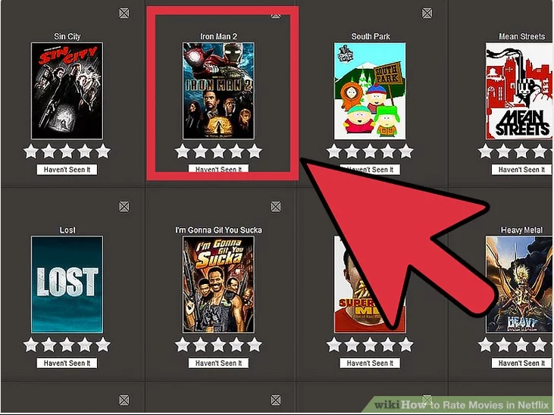
Copyright © www.ITbodhi.com

Slide 15
Similarity Measures
The similarity is measured using the distance metric.
Nearest points are the most similar and farthest points are the least relevant. The similarity is subjective and is highly dependent on the domain and application. For example, 2 movies are similar because of genre or length or caste.
Care should be taken when calculating distance across dimensions/features that are unrelated. The relative values of each element must be normalized, or one feature could end up dominating the distance calculation.
eg: Euclidean, Manhattan, Hamming Distance, Cosine similarity
Copyright © www.ITbodhi.com

Slide 16
Content-Based Recommender
Content-Based Recommendation System uses their knowledge about each product to recommend new products.
Users are suggested based on attributes of the item. Content-based Recommender works well when descriptive data on the content is provided before-hand. “Similarity” is measured against product attributes.
Suppose I watch a particular genre movie I will be recommended movies w.r.t that specific genre. The Title, Year of Release, Director, Cast are also helpful in identifying similar movie content
Copyright © www.ITbodhi.com

Slide 17
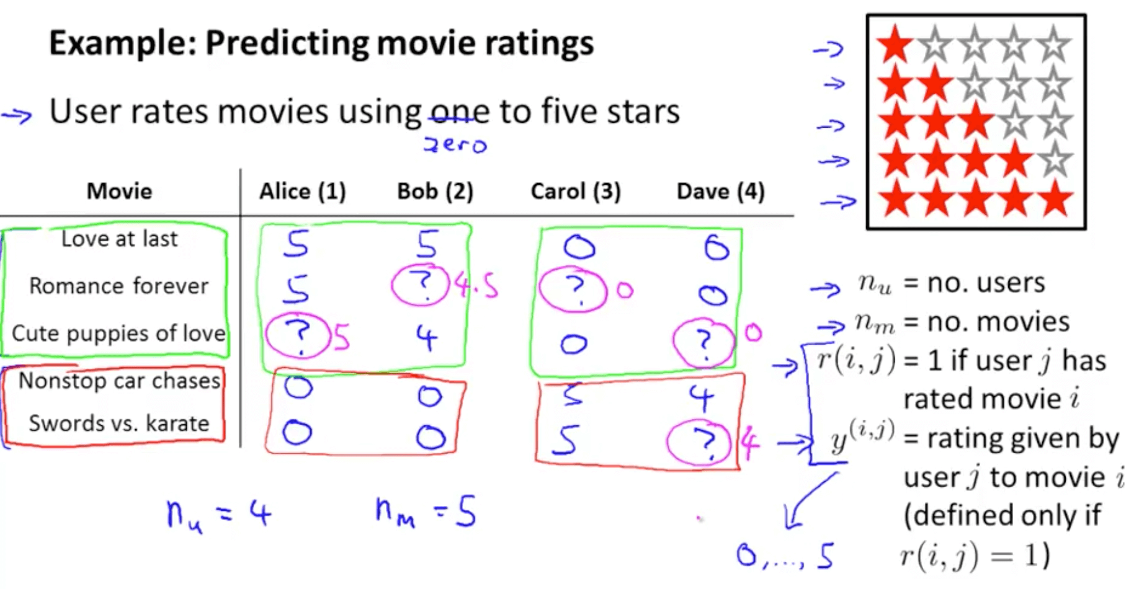
Using Rated Content to Recommend
In this approach contents of the product are already rated and based on the user’s preference a rating is predicted to a similar suggested product.
Copyright © www.ITbodhi.com

Slide 18
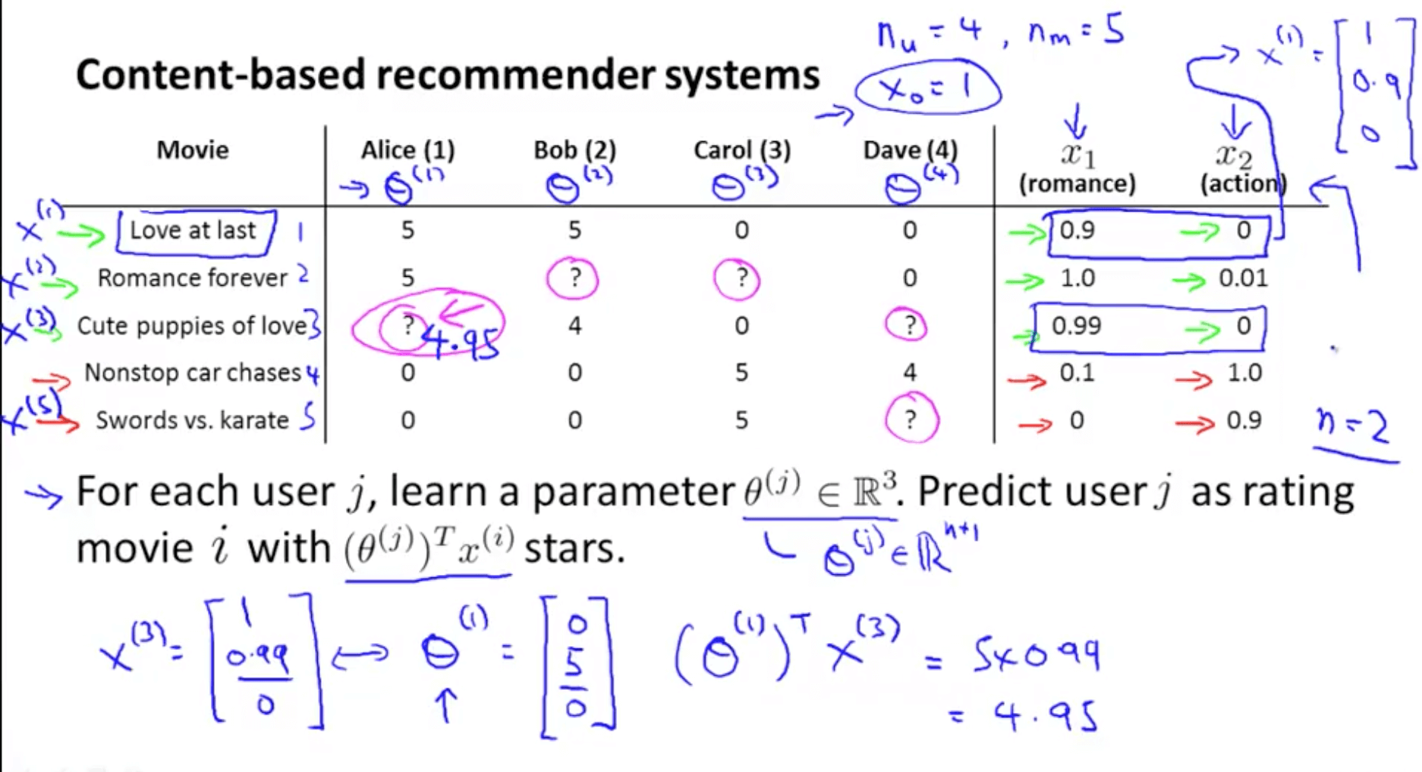
How do we predict the missing values?
Copyright © www.ITbodhi.com

Slide 19
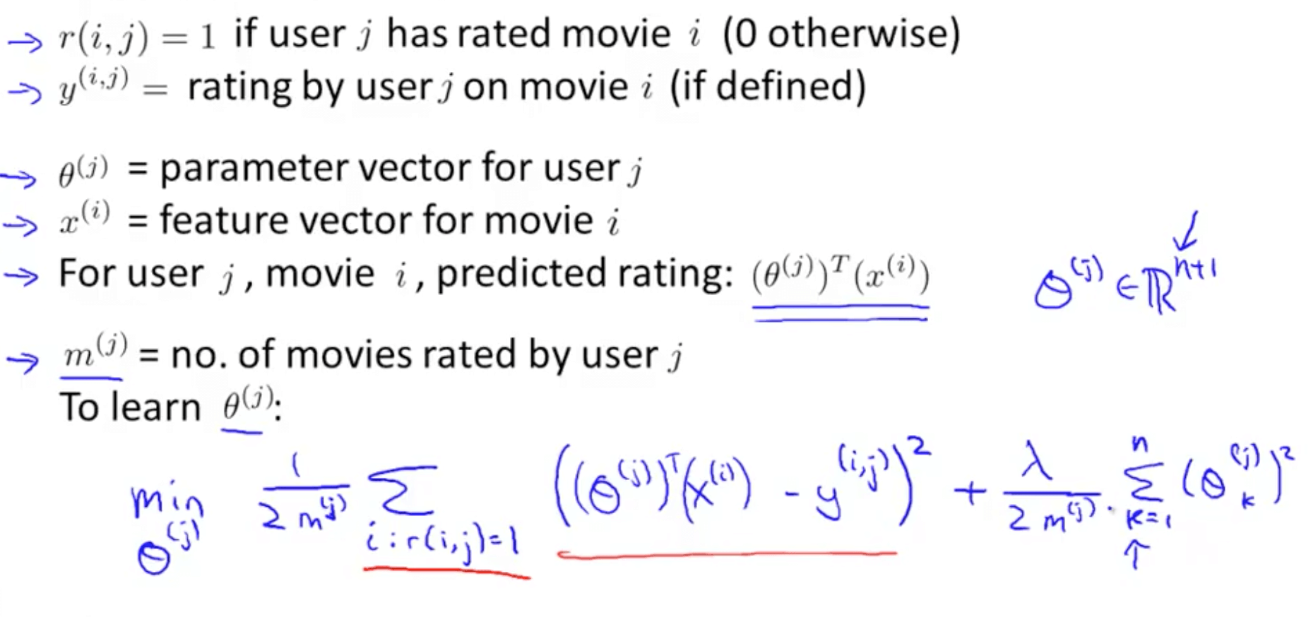
If we minimize the following function, we get the parameters to predict
Copyright © www.ITbodhi.com

Slide 20
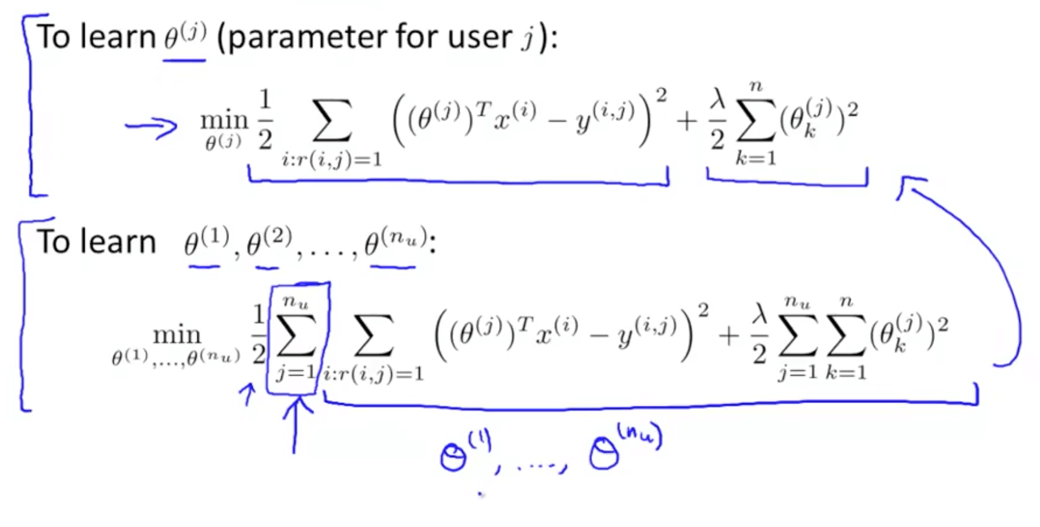
Copyright © www.ITbodhi.com

Slide 21
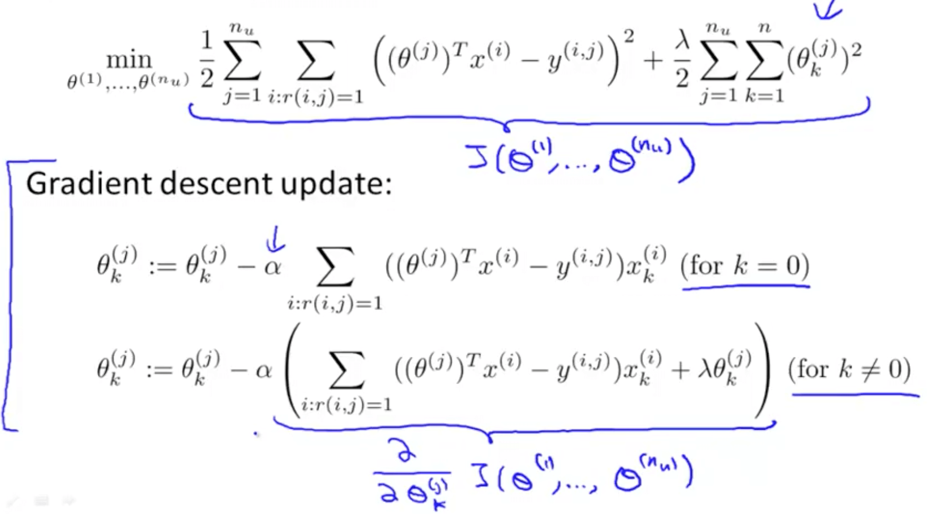
Now use gradient descent to minimize the cost.
We can use other minimization algorithms (other than gradient descent)
Copyright © www.ITbodhi.com

Slide 22
Advantages:
Works even when a product has no user reviews.
Disadvantages:
Require Descriptive data of all content to recommend which is time consuming. Difficult to implement on large product databases as user’s have different opinions on each item.
Copyright © www.ITbodhi.com

Slide 23
Collaborative Filtering Recommender
It is inefficient and difficult to ask someone to watch each movie and inform us how romantic or action-packed the movie is.
Collaborative Filtering Recommender makes the suggestion based on how users rated in the past and not based on the product themselves. It only knows how other customers rated the product. “Similarity” is measured against the similarity of users.
“Feature Learning” Feature Learning: Will be learning what features to use
Copyright © www.ITbodhi.com

Slide 24
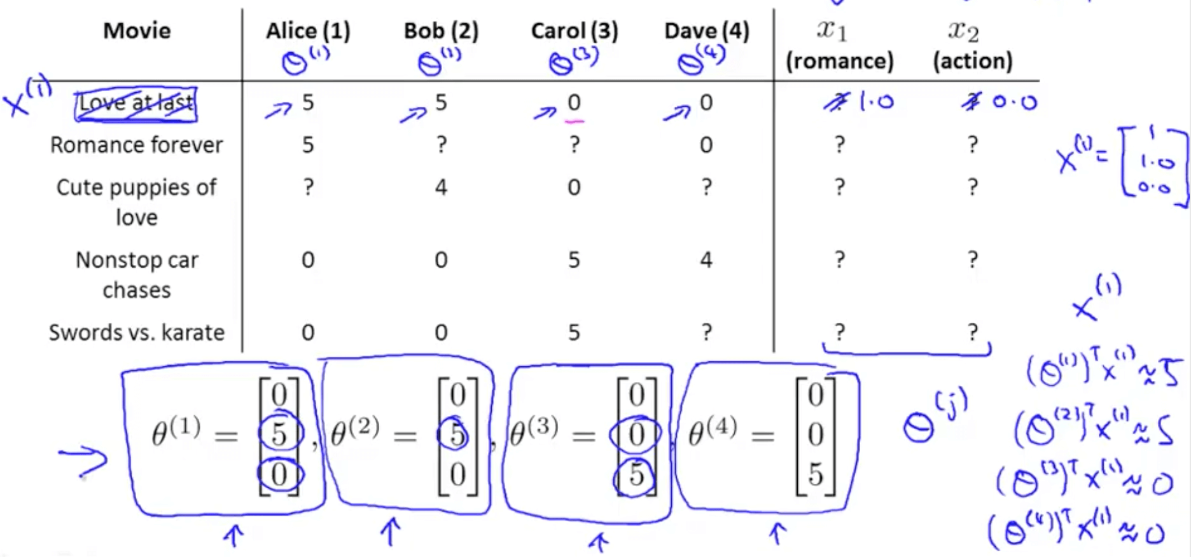
Copyright © www.ITbodhi.com

Slide 25
Now we’ve no idea how each movie is romantic (x1) or action-packed (x2)
Let’s say that
Alice (θ1): likes romance
Bob (θ2): likes romance
Carol (θ3): likes action
Dave (θ4): likes action
We can discover x_1 by making sure the following happens
θ1_transpose * x_1 = 5
θ2_transpose * x_1 = 5
θ3_transpose * x_1 = 0
θ4_transpose * x_1 = 0
Copyright © www.ITbodhi.com

Slide 26
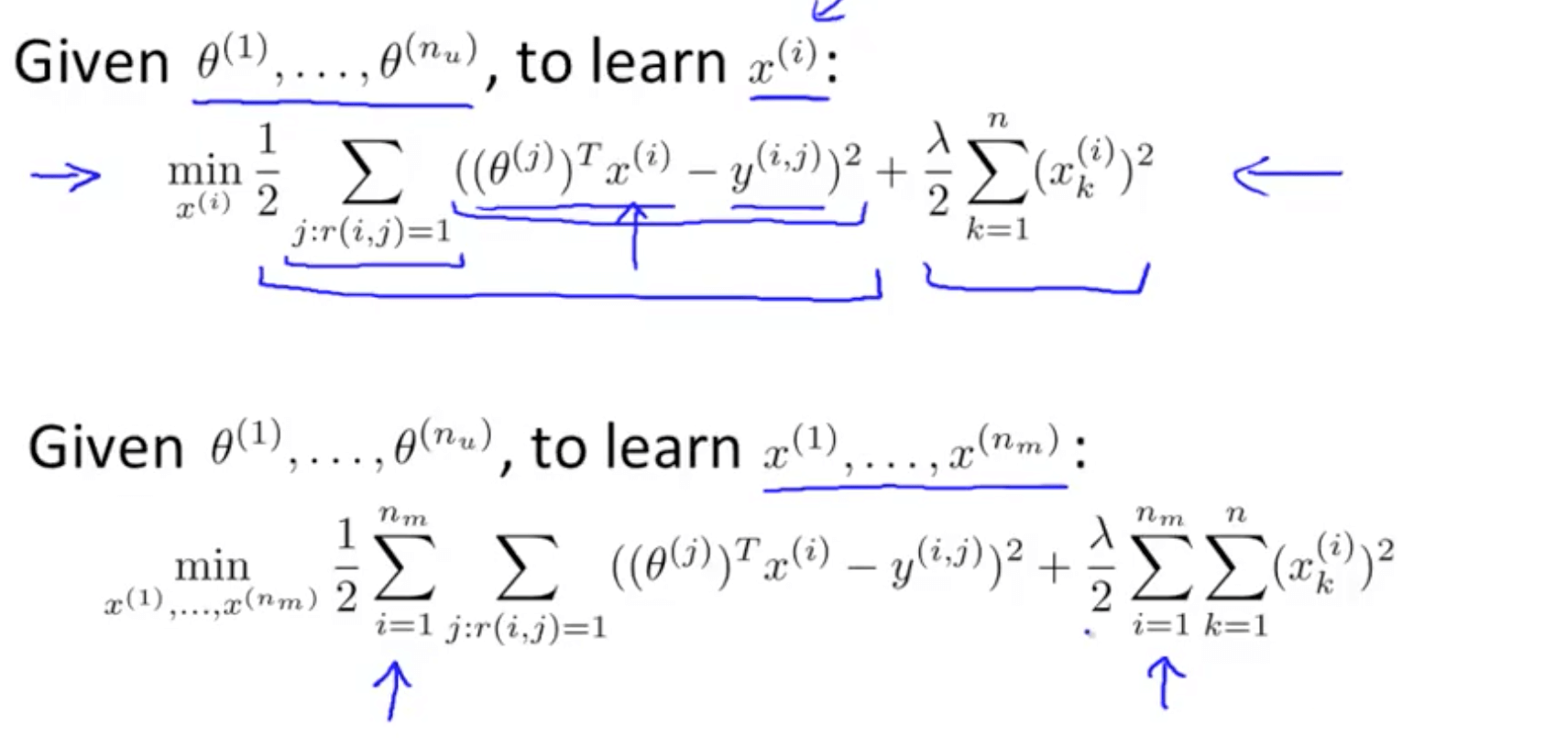
Copyright © www.ITbodhi.com

Slide 27
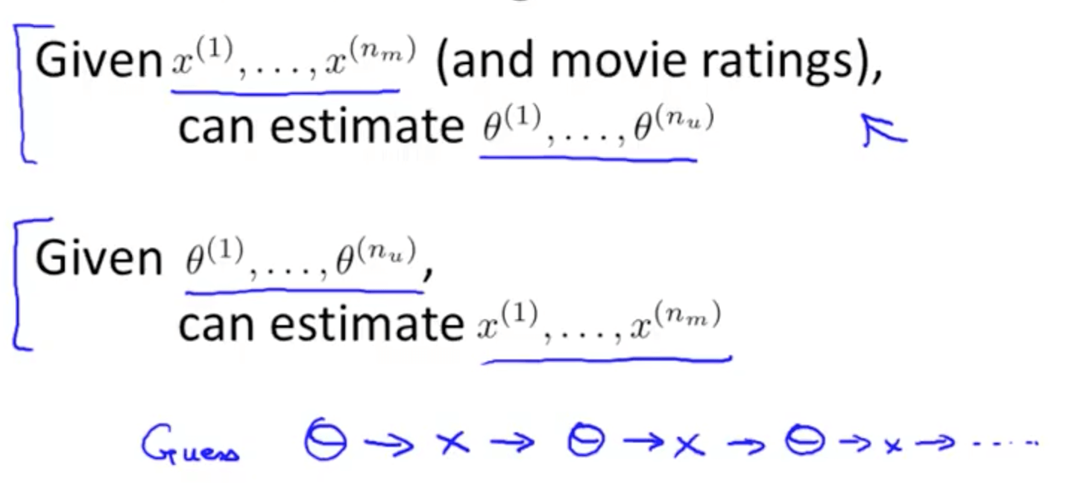
We can guess θ, solve for x, then solve for θ and continue till error minimized and converged.
Copyright © www.ITbodhi.com

Slide 28
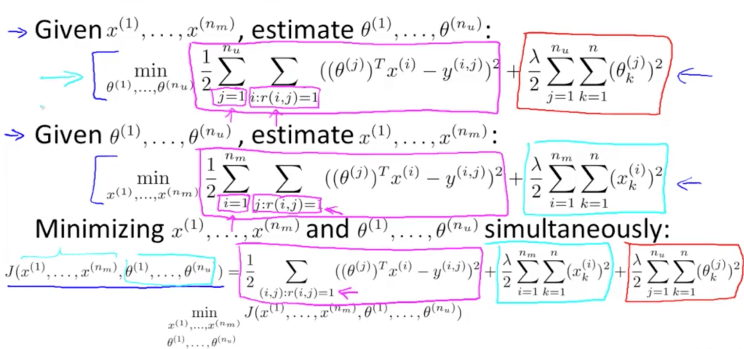
Collaborative Filtering Algorithm
Collaborative filtering optimization objective
We will take both of these optimization objectives and put them together
Now we get to minimize with respect to x and θ simultaneously
Copyright © www.ITbodhi.com

Slide 29
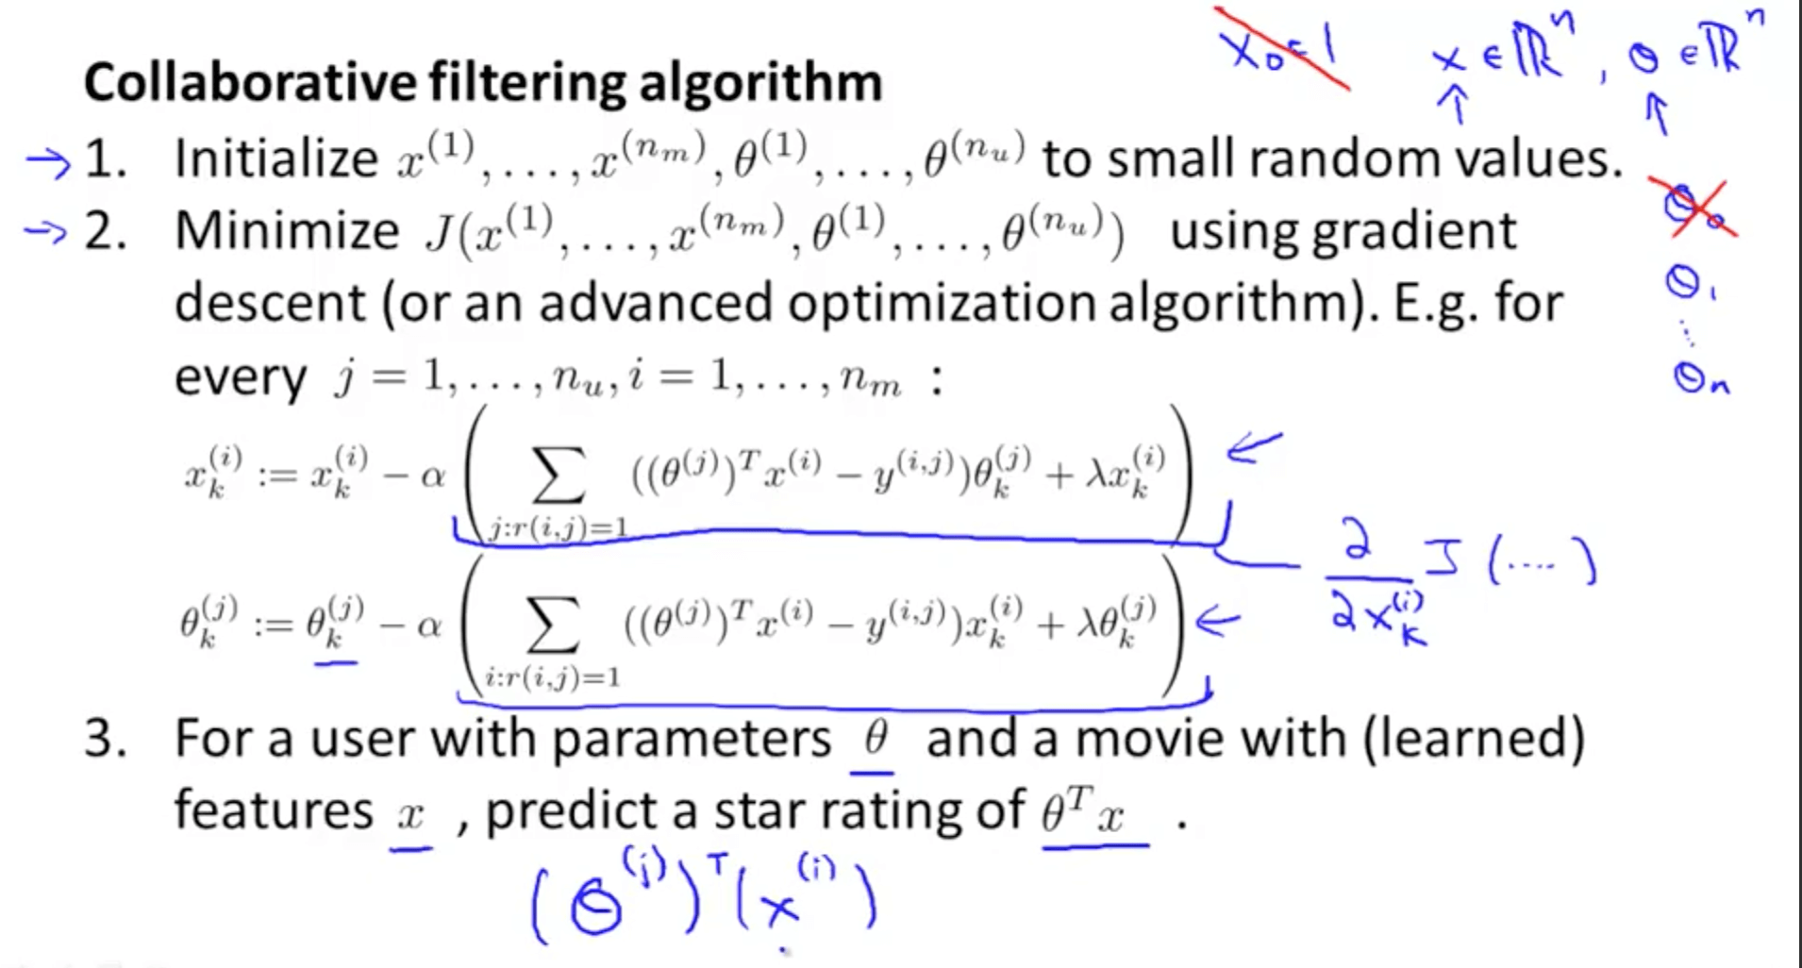
Copyright © www.ITbodhi.com

Slide 30
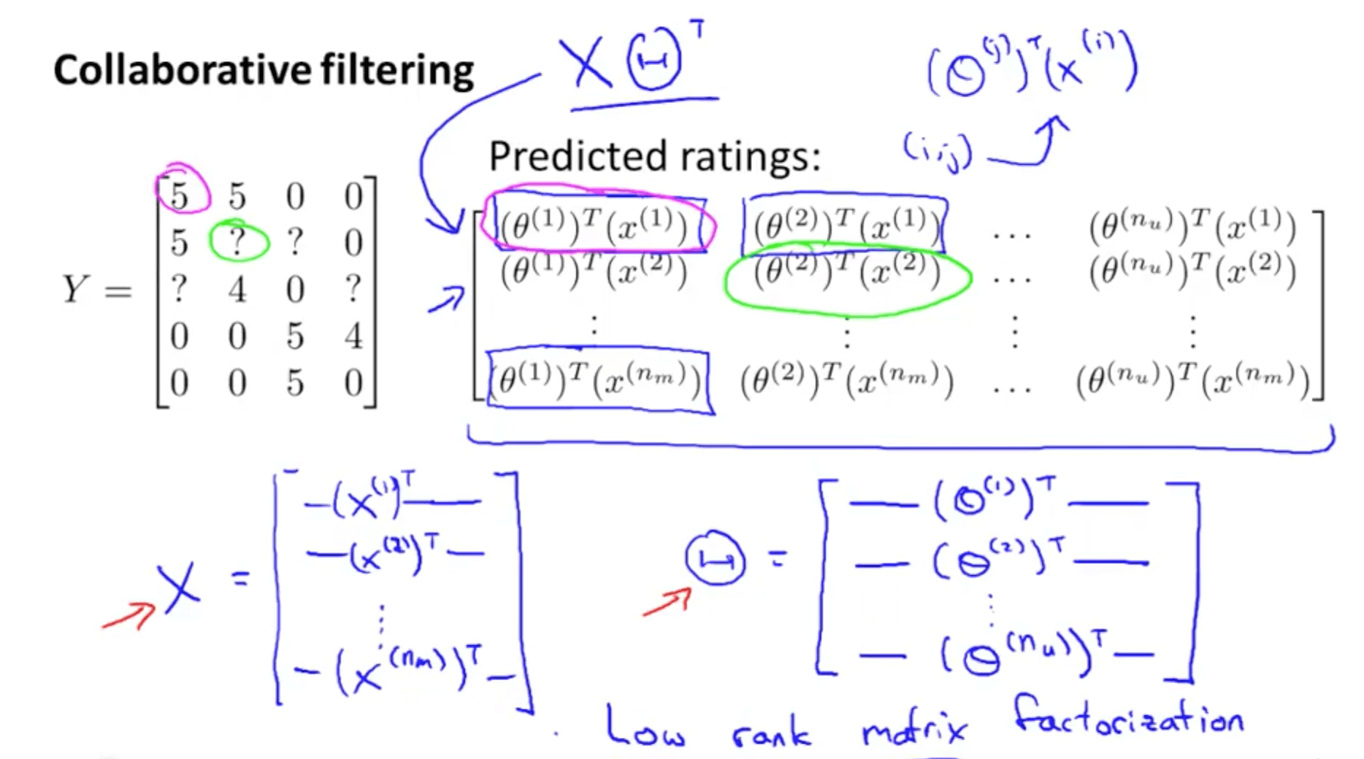
Low Rank Matrix Factorization
We conduct matrix factorization by decomposing the matrix into a product of matrices
X matrix: features of each movie stacked in rows
H matrix: parameters of each user stacked in rows
Product of X and H_transpose equals Y matrix
Copyright © www.ITbodhi.com

Slide 31
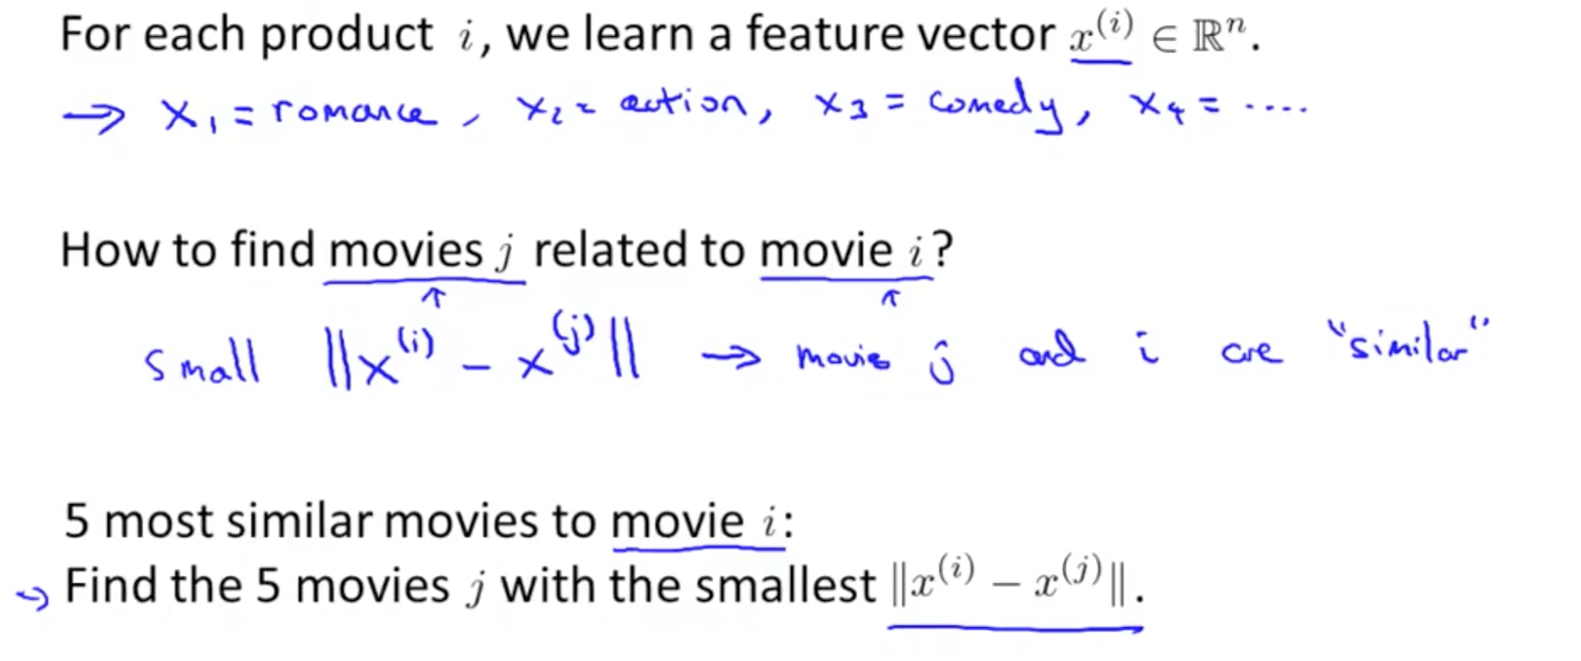
Finding Related Movies
Copyright © www.ITbodhi.com

Slide 32
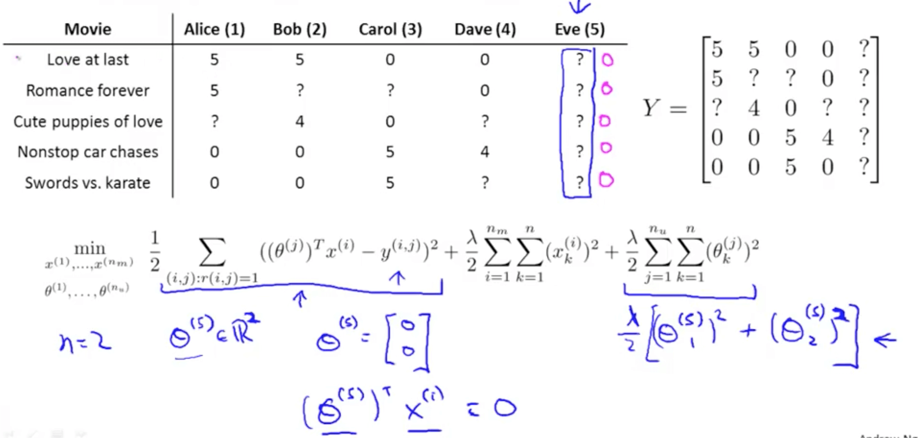
Implementation Detail: Mean Normalization
Lets say we have a user who does not ranked any of the movie yet.
Now how to recommend the movies to him?
As per current algorithm he will rank all movies 0 and that is not practical and useful.
Copyright © www.ITbodhi.com

Slide 33
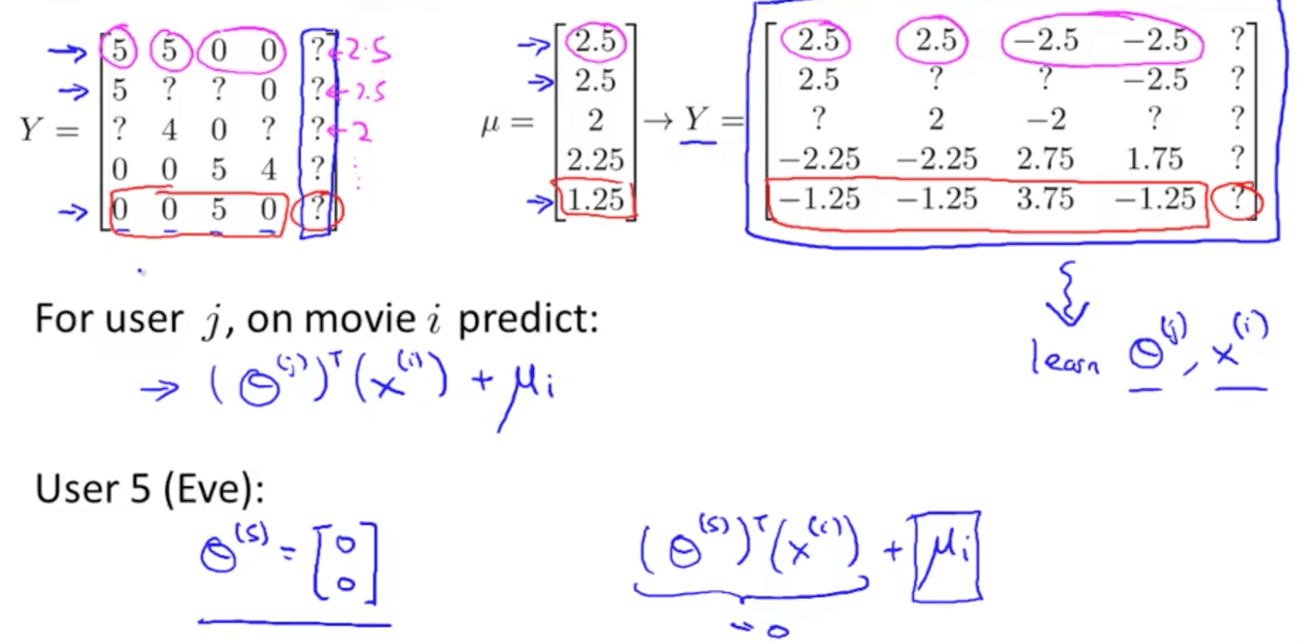
How do we solve the issue?
We can conduct mean normalization to solve this issue.
Our prediction would be the average of each movie
Copyright © www.ITbodhi.com

Slide 34
Disadvantages
Can’t recommend item if no user reviews i.e suffers from cold start problem.
Difficult to recommend new users.
Inclination to favor popular products with lots of reviews.
Suffers from sparsity problem as user will review only selected items.
Gray sheep problem i.e useful predictions cannot be made due to sparsity.
Difficult to recommend new releases as less reviews.
Copyright © www.ITbodhi.com

Slide 35
Singular Value Decomposition (SVD)
Most collaborative recommender systems perform poorly when dimensions in data increases i.e it suffers from the curse of dimensionality.
It is a good idea to reduce the number of features while retaining the maximum amount of information.
Reducing the features is called dimensionality reduction. Often while reducing we can get useful part of the data i.e hidden correlation(latent factors) and remove redundant parts.
There are many dimensionality reduction algorithms like Principal Component Analysis(PCA), Linear Discriminant Analysis(LDA) but SVD is used mostly in the case of recommender systems.
SVD uses matrix factorization to decompose matrix.
Copyright © www.ITbodhi.com

Slide 36
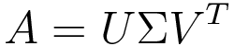
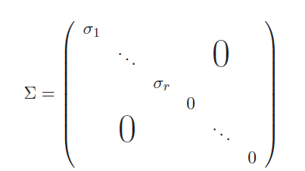
Where U is an m×m orthogonal matrix1 whose columns are the eigenvectors of AA^{T}
V is an n×n orthogonal matrix whose columns are the eigenvectors of A^{T} A,
∑ is an m×n diagonal matrix of the form
σ1 ≥ 2 ≥ ・ ・ ・ ≥ r > 0 and r = rank(A). In the above, 1, . . . , r are the square roots of the eigenvalues of ATA. They are called the singular values of A.
Copyright © www.ITbodhi.com

Slide 37
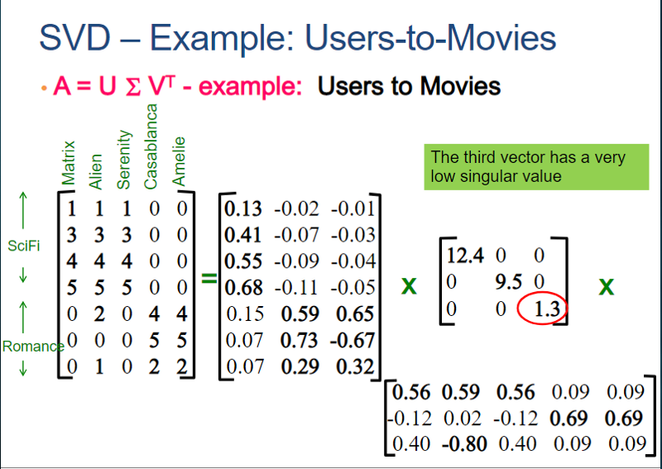
Copyright © www.ITbodhi.com

Slide 38
For U it shows user’s similarity to movie genre, So the first column of U represents weights that would match each user’s preference to Sci-Fi category. We can see that the 4th user rates Sci-Fi category highly. While the second column of U represents weights that would match each user’s preference to Romance category. We can see that 6th user rates Romantic category highly.
For the third column, we need to look at the Σ value given.
For Σ, The first diagonal entry represents the weight(strength)of Sci-Fi category i.e 12.4 and the second diagonal entry represents the weight(strength) of Romance category i.e 9.5. And as for the third diagonal entry for the value is lower compared to other diagonal entries, it is discarded. It is considered noise.
For V, The columns show the similarity of movies to a category. So, we can see from the first column of V that the 1st movie belongs to the Sci-Fi(0.56) category. Similarly, as the 3rd row is discarded as noise the 2nd movie is considered also belongs to Sci-Fi Category.
So, After Eliminating the 3rd column from U, 3rd row and 3rd column from Σ, and 3rd row we get the below matrices.
Copyright © www.ITbodhi.com

Slide 39
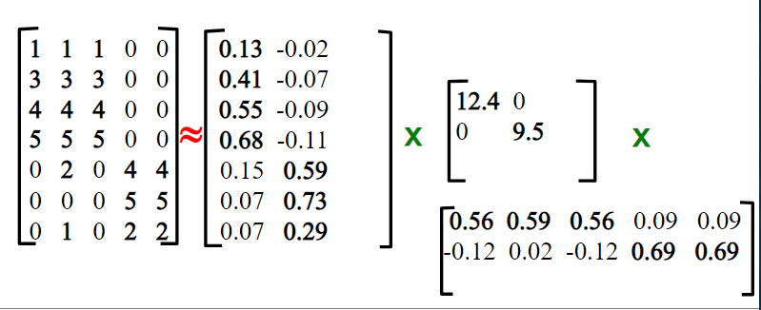
Copyright © www.ITbodhi.com

Slide 40
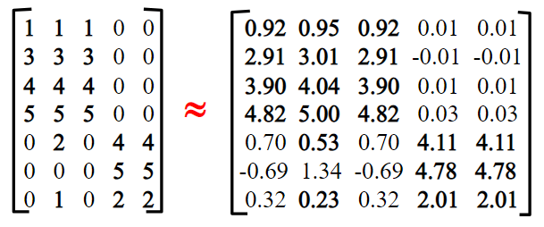
We have reduced the initial UΣV dimension, so to check if lost any information we need to multiply all 3 matrices.
On multiplying we see there is very little loss of information as elements of a matrix are very similar. It is similarly used for predicting missing values among ratings and suggest high ratings to the user.
So this is how we decompose a matrix without losing much of the important data and It helps to analyze and acquire important information concerning the matrix data.
Copyright © www.ITbodhi.com

Slide 41
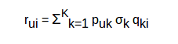
Now to get the rating rui for a movie qik rated by a user puk across all the latent features k, we can calculate the dot product of the 2 vectors and add them to get the ratings based on all the latent features.
This is how matrix factorization gives us the ratings for the movies which have not been rated by the users
Copyright © www.ITbodhi.com

Slide 42
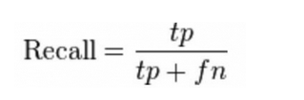
Evaluation metrics for recommendation engines
1. Recall : What proportion of items that a user likes were actually recommended
Here tp represents the number of items recommended to a user that he/she likes and tp+fn represents the total items that a user likes
If a user likes 5 items and the recommendation engine decided to show 3 of them, then the recall will be 0.6
Larger the recall, better are the recommendations
Copyright © www.ITbodhi.com

Slide 43
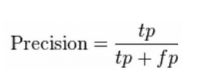
Evaluation metrics for recommendation engines
2. Precision : Out of all the recommended items, how many did the user actually like?
Here tp represents the number of items recommended to a user that he/she likes and tp+fp represents the total items recommended to a user
If 5 items were recommended to the user out of which he liked 4, then precision will be 0.8
Larger the precision, better the recommendations
But consider this case: If we simply recommend all the items, they will definitely cover the items which the user likes. So we have 100% recall! But think about precision for a second. If we recommend say 1000 items and user likes only 10 of them, then precision is 0.1%. This is really low. So, our aim should be to maximize both precision and recall.
Copyright © www.ITbodhi.com

Slide 44
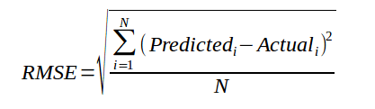
Evaluation metrics for recommendation engines
3. RMSE (Root Mean Squared Error): It measures the error in the predicted ratings
Here, Predicted is the rating predicted by the model and Actual is the original rating
If a user has given a rating of 5 to a movie and we predicted the rating as 4, then RMSE is 1
Lesser the RMSE value, better the recommendations
Copyright © www.ITbodhi.com

Slide 45
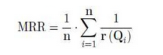
Evaluation metrics for recommendation engines
The earlier metrics tell us how accurate our recommendations are but they do not focus on the order of recommendations.
They do not focus on which product to recommend first and what follows after that.
Lets explore some other metrics that also considers the order of the products recommended.
4. Mean Reciprocal Rank: It measures the error in the predicted ratings
Suppose we have recommended 3 movies to a user, say A, B, C in the given order, but the user only liked movie C. As the rank of movie C is 3, the reciprocal rank will be 1/3
Larger the mean reciprocal rank, better the recommendations
Copyright © www.ITbodhi.com

Slide 46
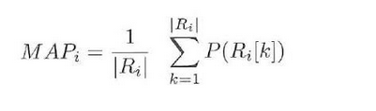
Evaluation metrics for recommendation engines
5. MAP at k (Mean Average Precision at cutoff k): Precision at cutoff k is the precision calculated by considering only the subset of your recommendations from rank 1 through k
Suppose we have made three recommendations [0, 1, 1]. Here 0 means the recommendation is not correct while 1 means that the recommendation is correct.
Then the precision at k will be [0, 1/2, 2/3], and the average precision will be (1/3)*(0+1/2+2/3) = 0.38
Larger the mean average precision, more correct will be the recommendations
Copyright © www.ITbodhi.com

Slide 47
Evaluation metrics for recommendation engines
6. NDCG (Normalized Discounted Cumulative Gain):
The main difference between MAP and NDCG is that MAP assumes that an item is either of interest (or not), while NDCG gives the relevance score
Let us understand it with an example: suppose out of 10 movies – A to J, we can recommend the first five movies, i.e. A, B, C, D and E while we must not recommend the other 5 movies, i.e., F, G, H, I and J. The recommendation was [A,B,C,D]. So the NDCG in this case will be 1 as the recommended products are relevant for the user
Higher the NDCG value, better the recommendations
Copyright © www.ITbodhi.com

Slide 48
Association Rules Learning
Association Rules Learning is used for recommending user complementary product. It helps in associating one product with another product. It tries to answer which products are associated with one another. It is mostly used in e-commerce as user’s tend to buy a product paired with the main product i.e complements it
Copyright © www.ITbodhi.com

